Slide 1
The cell biology lab 8
Types of Chromosomes and Special chromosomes

Slide 2
The chromosome primarily consists of DNA and protein,
Distinguished by size and shape ,
Essential parts are:
- Telomeres (A telomere is a region of repetitive DNA at the end of a chromosome, which protects the end of the chromosome from deterioration).
- Origins of replication sites ( Chromatin ) .
- Centromere.
Chromatin : The chromatin has two forms: ( Euchromatin and Heterochromatin) .

Slide 3
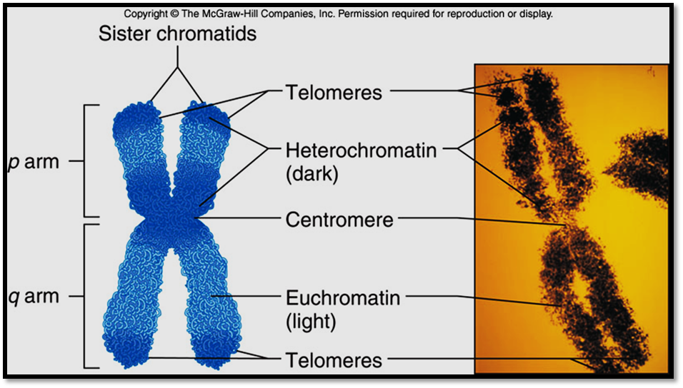

Slide 4
Heterochromatin | Euchromatin
1- It is darkly stained region of the chromatin (chromosome). | 1. It is lightly stained region.
2. It is compactly coiled regions and with more DNA. | 2. It is loosely coiled region and with less DNA.
3. It is genetically inert as can not transcribe mRNA due to tight coiling. | 3. It is genetically active.
4. It is late replicative | 4. It is early replicative.
5. Heterochromatin is only found in eukaryotes | 5. Euchromatin is found in eukaryotes, cells with nuclei, and prokaryotes, cells without nuclei.

Slide 5
Centromere Positions: according to the centromere positions there’s four types of chromosomes :
– Telocentric (Telocentric chromosomes have the centromere at the very end of the chromosome. Humans do not possess telocentric chromosomes but they are found in other species such as mice).
– Acrocentric (Acrocentric chromosomes have a centromere which is severely offset from the center leading to one very long

Slide 6
and one very short section. Human chromosomes 13,15, 21, and 22 are a cro centric).
– Sub metacentric (Sub metacentric chromosomes have the centromere slightly offset from the center leading to a slight asymmetry in the length of the two sections. Human chromosomes 4 through 12 are sub metacentric).
– Meta centric (Metacentric chromosomes have the centromere in the center, such that both sections are of equal length. Human chromosome 1 and 3 are meta centric).

Slide 7
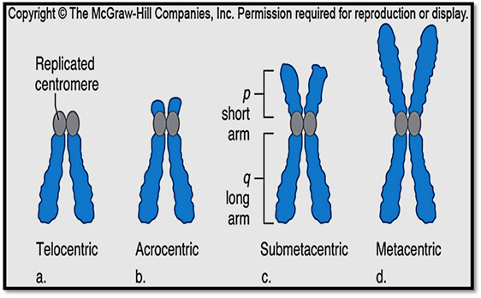

Slide 8
Special Chromosomes
1- Giant chromosomes: There are chromosomes, which are extremely large compared to normal chromosomes called giant chromosomes occur in some animal cells. Two types of giant chromosomes are known: a-Lamp Brush Chromosome: This chromosome occur in the oocytes (germcells in the ovary) of amphibians and in some insects. They measure about 1500 to 2000 in length. A lampbrush chromosome consists of an axis from which paired loops extend in opposite directions, giving the appearance of a lamp brush. The axis consists of chromomeres (nucleosomes) and interchromomere regions. The loops consist of transcriptionally active DNA, which can synthesize large amount of mRNA, necessary for the synthesis of yolk.

Slide 9
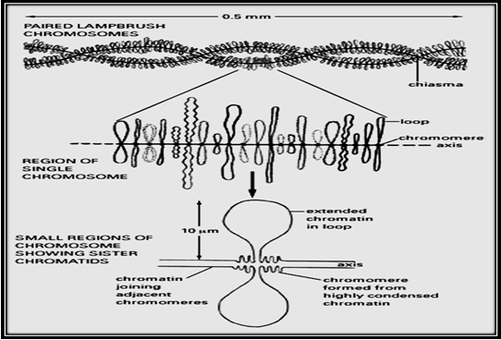

Slide 10
b-Polytene Chromosome: This chromosome found in the salivary gland cells of the fruitfly Drosophila. They are many times larger than the normal chromosomes reaching a length of 2000 and are visible even under a compound microscope. The polytene chromosome appear to contain five long and one short arm radiating from a central point called chromocentre. Some of the dark bands temporarily swell up and form enlargements called chromosomal puffs or Balbiani rings. These regions contain actively transcribing DNA involved in the synthesis of RNA types.

Slide 11
2- Accessory chromosomes: Any chromosome that is additional to the regular karyotype of a species. Such chromosomes vary in size and composition and may or may not affect the phenotype. In humans, about one person in every 1500 carries an accessory chromosome, and some of these are associated with mental or physical abnormalities. For example, cat-eye syndrome occurs in people who carry an extra chromosome that partly duplicates chromosome 22.

Slide 12
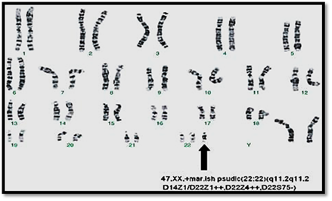

Slide 13
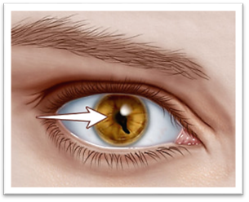

Slide 14
3- B-chromosomes: Many plant (maize, etc.) and animal (such as insects and small mammals) species, besides having autosomes (A-chromosomes) and sex chromosomes possess a

Slide 15
special category of chromosomes called B-chromosomes without obvious genetic function. These B-chromosomes (also called supernumerary chromosomes, accessory chromosomes, accessory fragments, etc.) usually have a normal structure, are somewhat smaller than the autosomes and can be predominantly, heterochromatic.

Slide 16
